Slide 1
Non-deterministic Finite Automaton (NFA)
CSC3113: Theory of Computation
6
3
Summer 2020-2021
Dr Hossain Md Shakhawat , Assistant Professor,
Department of Computer Science, Faculty of Science & Technology.
shakhawat@aiub.edu

Slide 2
DFA-NFA Equivalence.
Nondeterministic Finite Automata (NFA).
Practice, solve exercise of NFA.
Closure under regular operations.

Slide 3
Equivalence of DFA & NFA.
Understand, learn & practice with example
Practice designing NFA.
Understanding closure under regular operation for NFA.

Slide 4
All outcome are represented with examples
Equivalence of DFA & NFA.
Conversion from NFA to DFA.
Practice & Design of NFA
Closure under regular operations for NFA.

Slide 5
What is Equivalence
Two automata/machines are equivalent if their languages are the same. If M1 and M2 machines are equivalent if their languages same same as L(M1) = L(M2)
Equivalence between NFA and DFA: for every NFA there is an equivalent DFA and vice-versa (we will prove it).

Slide 6
Equivalence between NFA & DFA
Every DFA is an NFA, but every NFA is not DFA.
The main difference is transition function: {Q, Σ, q_{o}, F, δ}
In DFA for an input there is one output state, but in NFA it can be one or more output states
In other words: For DFA Q × Σ → Q while for NFA Q × Σ → 2^{Q}
From set theory, we know that Q is contained in 2^{Q} . But 2^{Q} is not contained in Q (Every DFA is an NFA, but every NFA is not DFA)
However, for every NFA it is possible to derive an equivalent DFA

Slide 7
Equivalence between NFA & DFA
Every NFA has an equivalent DFA.
Let N = (Q, Σ, δ, q₀, F) be the NFA recognizing some language A.
Construct a DFA M = (Q′, Σ, δ ′, q₀′, F′) which recognizes A.
Q′= P(Q), power set of Q.
Every state of M is a set of states of N.
Let E(R) = {q | q can be reached from R⊆Q by traveling along 0 or more ε arrows, including the members of R themselves}.
For B∈Q′ and a∈Σ, δ ′(B, a)={q ∈Q′ | q ∈E(δ (r, a)) for some r ∈B}.
Each state B may go to a set of states after reading any symbol a. So, we take the union of all these sets.
q₀′ = E({q₀}).
M starts at the state corresponding to the collection containing all the possible states that can be reached from the start state of N along with the ε arrows.
F′ = {D ∈Q′| D contains an accept state of N}.

Slide 8
NFA-DFA Equivalence
Equivalent DFA M = (Q, Σ, δ, q₀, F)
Q = P(Q₂) = P({b₁,b₂,b₃})
Q = { φ, {b₁}, {b₂}, {b₃}, {b₁, b₂}, {b₁, b₃},
{b₂, b₃}, {b₁, b₂, b₃} };
δ is given as – _ ⏐ 0 1
φ ⏐
{b₁} ⏐
{b₂} ⏐
{b₃} ⏐
{b₁, b₂} ⏐
{b₁, b₃} ⏐
{b₂, b₃} ⏐
{b₁, b₂, b₃} ⏐
Σ = {0, 1}.
q₀ = E({b₁}) = {b₁, b₃} is the start state;
F = {{b₁}, {b₁, b₂}, {b₁, b₃}, {b₁, b₂, b₃}}.
b₁
0
1
ε
0
φ
φ
{b₂, b₃}
{b₁, b₃}
{b₂, b₃}
{b₁, b₃}
{b₁, b₂, b₃}
{b₁, b₂, b₃}
φ
{b₂}
{b₃}
φ
{b₂, b₃}
{b₂}
{b₃}
{b₂, b₃}
b₂
b₃
0,1
Let, the above NFA N₂=(Q₂, Σ, ₂, b₁, F₂).
Q₂ = {b₁,b₂,b₃}; Σ = {0,1};
b₁ = start state; F₂ = {b₁}. ₂ is given as –
 0 1  .
b₁  {b₂} {b₃}
b₂  {b₂, b₃} {b₃} 
b₃  {b₁}  

Slide 9
NFA-DFA Equivalence
Equivalent DFA M = (Q, Σ, δ, q₀, F)
Q = {b₁,b₂,b₃} = P(Q)
Q = { φ, {b₁}, {b₂}, {b₃}, {b₁, b₂}, {b₁, b₃},
{b₂, b₃}, {b₁, b₂, b₃} };
δ is given as – _ ⏐ 0 1
φ ⏐ φ φ
{b₁} ⏐ φ {b₂}
{b₂} ⏐ {b₂, b₃} {b₃}
{b₃} ⏐ {b₁, b₃} φ
{b₁, b₂} ⏐ {b₂, b₃} {b₂, b₃}
{b₁, b₃} ⏐ {b₁, b₃} {b₂}
{b₂, b₃} ⏐ {b₁, b₂, b₃} {b₃}
{b₁, b₂, b₃} ⏐ {b₁, b₂, b₃} {b₂, b₃}
Σ = {0, 1}.
q₀ = E({b₁}) = {b₁, b₃} is the start state;
F = {{b₁}, {b₁, b₂}, {b₁, b₃}, {b₁, b₂, b₃}}.
{b₁}
1
0
{b₂}
1
{b₁, b₃}
0
1
0
0
{b₂, b₃}
1
{b₃}
1
0
1
0, 1
{b₁, b₂, b₃}

{b₁, b₂}
0
0, 1
Remove the states with no incoming arrows.

Slide 10
Closure Under Regular Operations
Let,
N₁ = (Q₁, Σ, δ₁, a₁, F₁) recognizes A₁.
N₂ = (Q₂, Σ, δ₂, b₁, F₂) recognizes A₂.
UNION: Construct N = (Q, Σ, δ, q₀, F) to recognize A₁∪ A₂.
Q = {q₀} ∪ Q₁ ∪ Q₂.
q₀ is the starting state.
F = F₁ ∪ F₂.
For any q ∈Q and a ∈Σ_{ε},
N₁
N₂
a₁
b₁
N

q₀

a₁
b₁

Slide 11
B₆ ={w| w has at least two 1s}.
B7 ={w| w has at most two 1s}.
B11 ={w| w has at least two 1s or w has at most two 1s}.
∑ = {0,1}
0
0
0, 1
B₆
1
1
q1
q2
q3
ε
B11
q7
0
0
ε
B7
1
1
q4
q5
q6
0

Slide 12
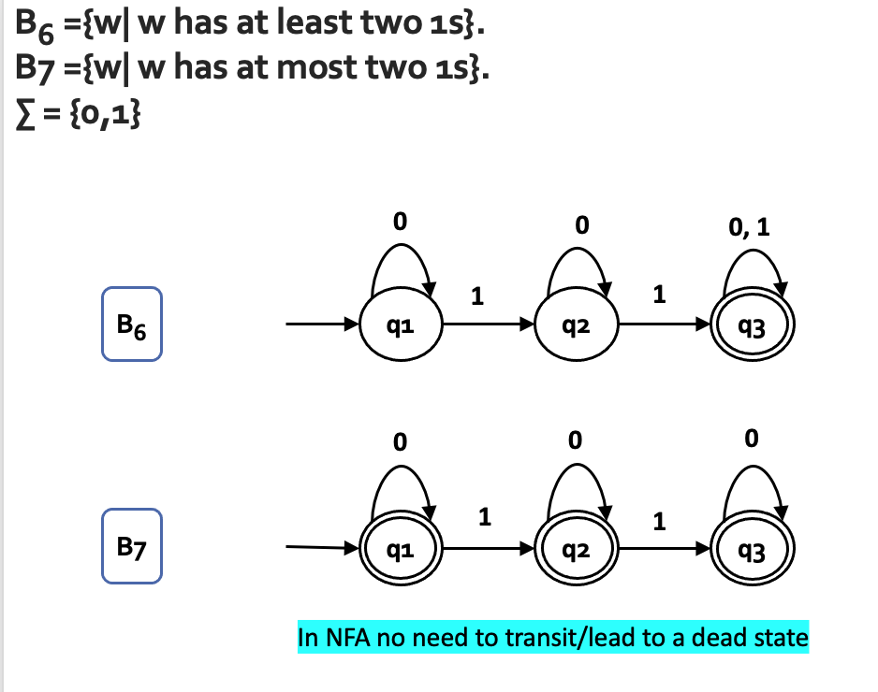
How was NFAs

Slide 13
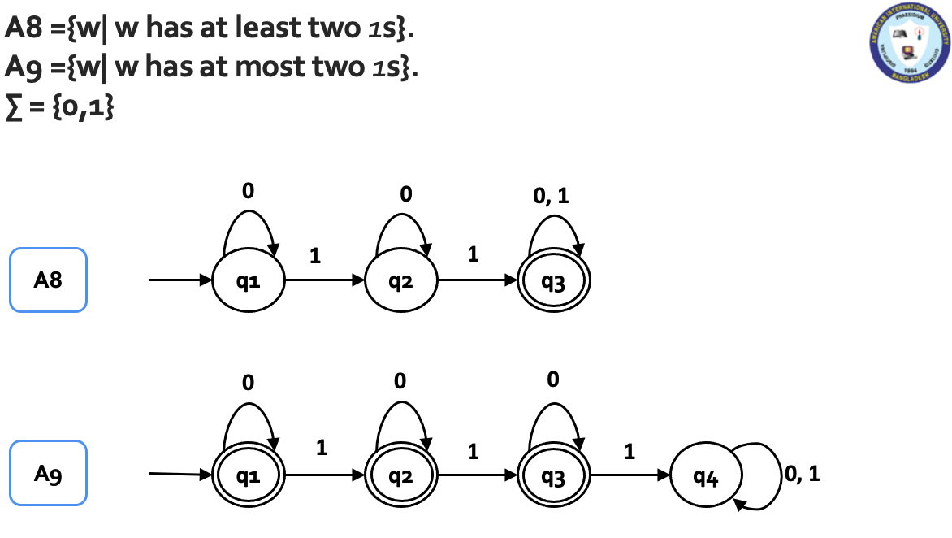
How was DFA?

Slide 14
Closure Under Regular Operations
Let,
N₁ = (Q₁, Σ, δ₁, a₁, F₁) recognizes A₁.
N₂ = (Q₂, Σ, δ₂, b₁, F₂) recognizes A₂.
CONCATENATION: Construct N = (Q, Σ, δ, q₀, F) to recognize A₁° A₂.
Q = Q₁ ∪ Q₂.
q₀ = a₁.
F = F₂.
For any q ∈Q and a ∈Σ_{ε},
N₁
N₂
a₁
b₁
N

b₁
a₁


Slide 15
B₆ ={w| w has at least two 1s}.
B7 ={w| w has at most two 1s}.
B12 ={w| w has at least two 1s followed by w has at most two 1s}.
∑ = {0,1}
0
0
0, 1
B₆
1
1
q1
q2
q3
B12
ε
0
0
B7
1
1
q4
q5
q6
0

Slide 16
Closure Under Regular Operations
Let,
N₁ = (Q₁, Σ, δ₁, a₁, F₁) recognizes A₁.
STAR: Construct N = (Q, Σ, δ, q₀, F) to recognize A₁*.
Q = {q₀} ∪ Q₁.
q₀ is the new start state.
F = {q₀} ∪ F₁.
For any q ∈Q and a ∈Σ_{ε},
N₁
a₁
N
q₀

a₁



Slide 17
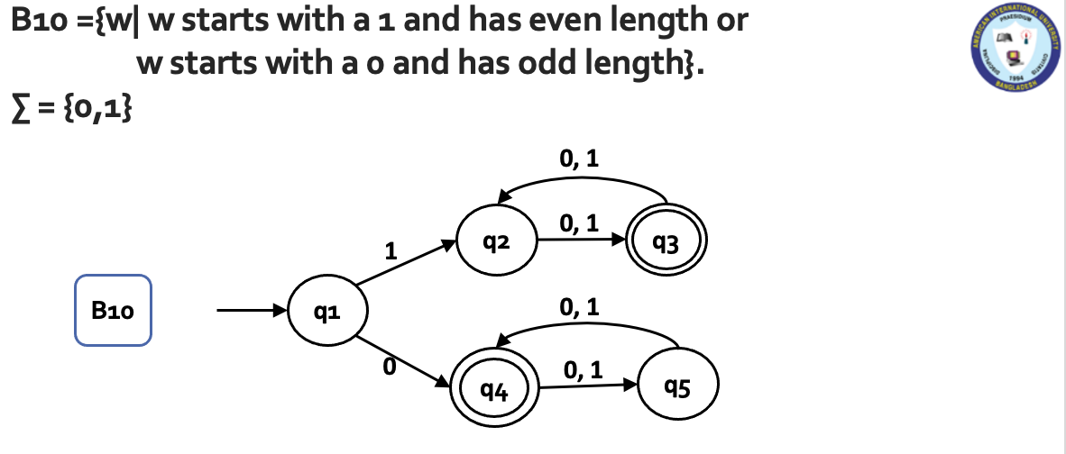
How was NFA

Slide 18
B10 ={w| w starts with a 1 and has even length or w starts with a 0 and has odd length}.
Find B10* for ∑ = {0,1}
0, 1
ε
q2
0, 1
q3
1
qs
ε
q1
B10*
0, 1
0
q4
0, 1
q5
ε

Slide 19
NFA to DFA Complexity
• If the original NFA N has n states, how large can the corresponding DFA M be?
Answer: 2^{n} states
Practice Exercise: construct an example where N has n states and M has Θ(2^{n}) states

Slide 20
All exercises for Finite Automata & Regular Language
Same as previous Lecture…
Elements of the Theory of Computation, Papadimitriou (2nd ed), All exercises.
Introduction to Automata Theory, Languages, and Computations, Hopcroft, All exercises.

